Slide 1
Volume of Rectangular Prism

Slide 2
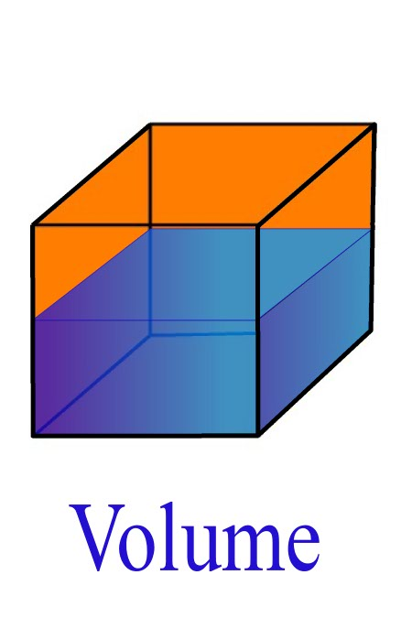
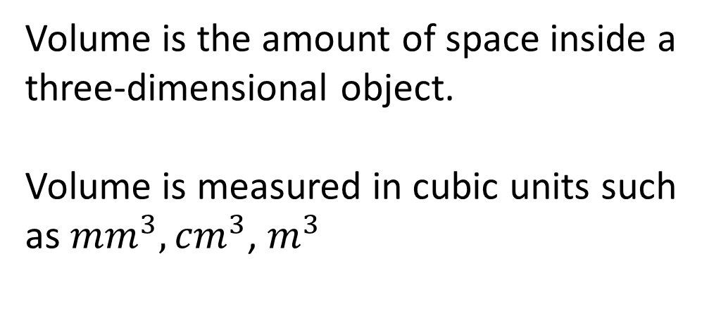
24
7
30
Volume of a Rectangular Prism
Date
EQ – How do we calculate the volume of a prism?
What is Volume?
Volume is the amount of space inside a three-dimensional object.
Volume is measured in cubic units such as ${mm}^{3},{cm}^{3}$, $m^{3}$

Slide 3
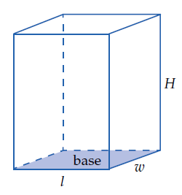
24
7
30
Volume of a Rectangular Prism
Date
EQ – How do we calculate the volume of a prism?
Rectangular Prisms Formula
Volume = length x width x height
= L x W x H

Slide 4
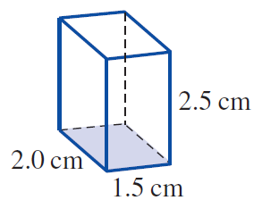
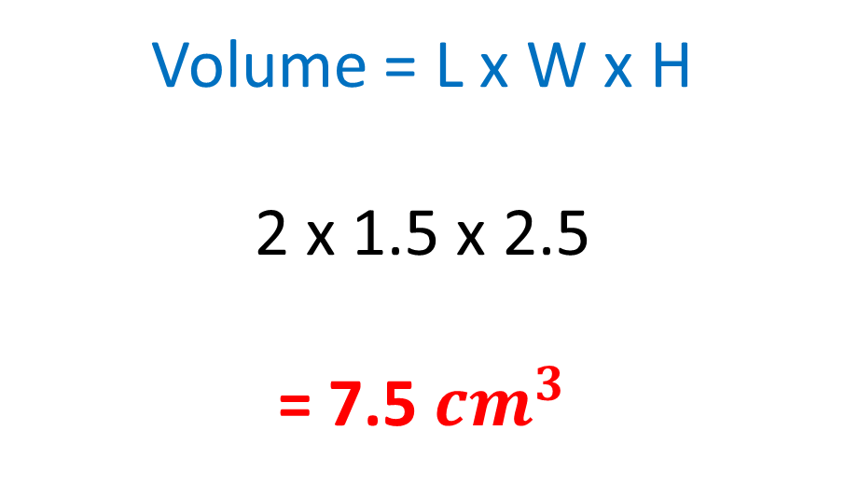
Practise
Volume = L x W x H
2 x 1.5 x 2.5
= 7.5 ${cm}^{3}$

Slide 5
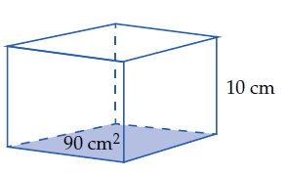
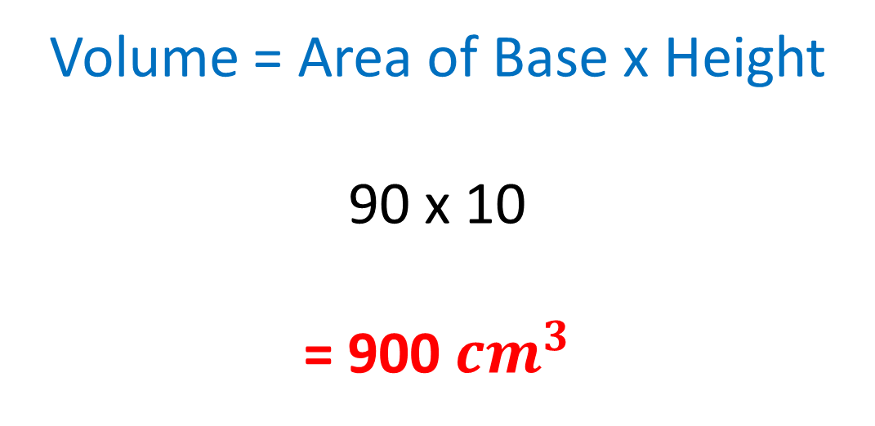
Practise
Volume = Area of Base x Height
90 x 10
= 900 ${cm}^{3}$

Slide 6
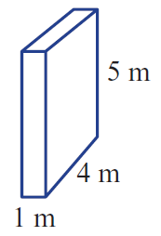
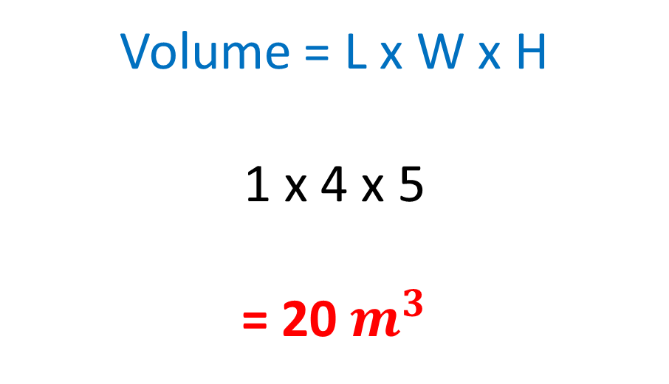
Practise
Volume = L x W x H
1 x 4 x 5
= 20 $m^{3}$

Slide 7
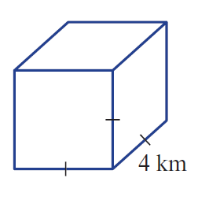
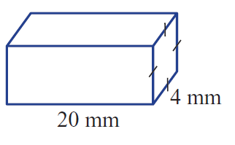
Your Turn
Find the Volume

Slide 8
Task
Worksheet - Freefall

